Slide 1
Juniors
Are You Ready Your Senior Year?

Slide 2
Where Do I Begin?
Create a Professional Email
You should use this email for all university applications.
Check this email often once you submit your application(s).
Review your social media image, i.e TikTok, Instagram, Twitter, etc. and CLEAN IT UP as needed.
When in doubt: Delete, Delete, Delete.
#1 & 2

Slide 3
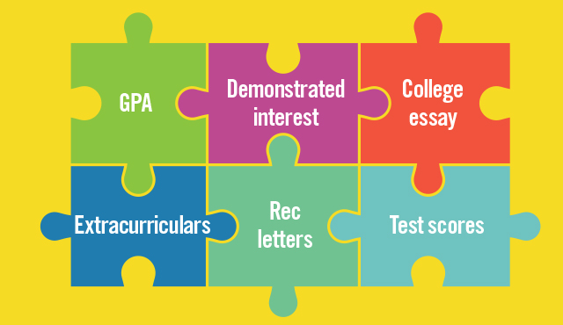
What Do Universities Consider When Reviewing My Application?
Strong GPA
Rigorous Coursework – 5 academically oriented courses
which can include upper level electives
Competitive Test Scores
Test Optional Schools – Greater emphasis is placed on
GPA, rigor of coursework, & resume strengths
Holistic Application Review to include: leadership, community service, extracurricular involvement, honors & awards, character & self-growth

Slide 4
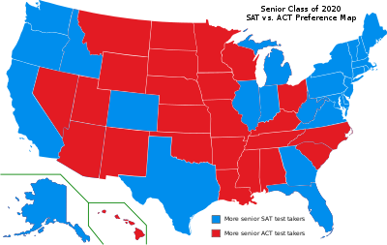
Which Test Is Best For Me?
SAT:
SECTIONS: reading, writing & language, math
Length: 3 hours
Reading: 5 passages
Science: none
Math: Algebra I & II, geometry, trigonometry & data analysis
Calculator – not allowed on some questions
ACT:
SECTIONS: English, math, reading & science
Length: 3 hours
Reading: 4 passages
Science: Tests critical thinking skills, not specific knowledge
Math: Algebra I & II, geometry, trigonometry, and probability and statistics
Calculator: Used with all questions
IT is HIGHLY RECOMMENDED that you take both tests to see which tests you are
most successful on. Score conversion charts can be found on the internet. #3 & 4

Slide 5
What is SCOIR?
An online FREE resource that helps you:
Identify your aptitudes
Identify Career fields
Identify College programs & majors
Access your “acceptance predictor”
Organize your personal profile
https://www.scoir.com/students-families?hsLang=en-us
# 5

Slide 6
Why Is My Resume Important?
Your resume allows schools to learn more about you and your interests.
Many applications request that upload a resume.
Many scholarship applications require a resume.
A sample format is in your packet – Keep the resume to 1 page with your most important high school accomplishments highlighted.
(#6)

Slide 7
College Applications: The Honors & Awards Section
Include HIGH SCHOOL recognition(s) ordered from most important to least; do not include middle school awards.. Remember, 1 page resumes get reviewed.
HONOR SOCIETIES
SCHOOL AWARDS
AP SCHOLAR AWARDS
AICE DIPLOMA

Slide 8
Plan for an Eventful Summer!
Take a dual enrollment course or two at PBSC
Find/apply for an internship in an area of your intended major
Get involved in a summer community service project
Job shadow
Work; get a summer job
(#7)

Slide 9
How Many Schools Should I Apply To and When Do I Start? (see matrix)
Reach 1 – 2
Your GPA & Test Scores are in the lower range of the mid 50% on the school’s freshman profile
Reasonable 2 – 3
Your GPA & Test Scores are in the mid to upper range of the mid 50%
Safety 1 – 2
Your GPA & Test Scores exceed the mid 50%
NOTE: If you are applying out of state, your list will be lengthier. Many students begin the college application process in September – see matrix and application timelines.

Slide 10
State University System Matrix Mid-50% range for GPA & Test Scores
Type of preferred application, i.e. institution, Common Application, Coalition, etc.
Middle range test scores & GPA for both summer and fall sessions
How grades/transcripts should be submitted, i.e. SSAR, official transcript, SPARK
Whether Super Scoring is used
Type of admissions, i.e. rolling or deadlined and dates
Cost
pg. 4 in packet

Slide 11
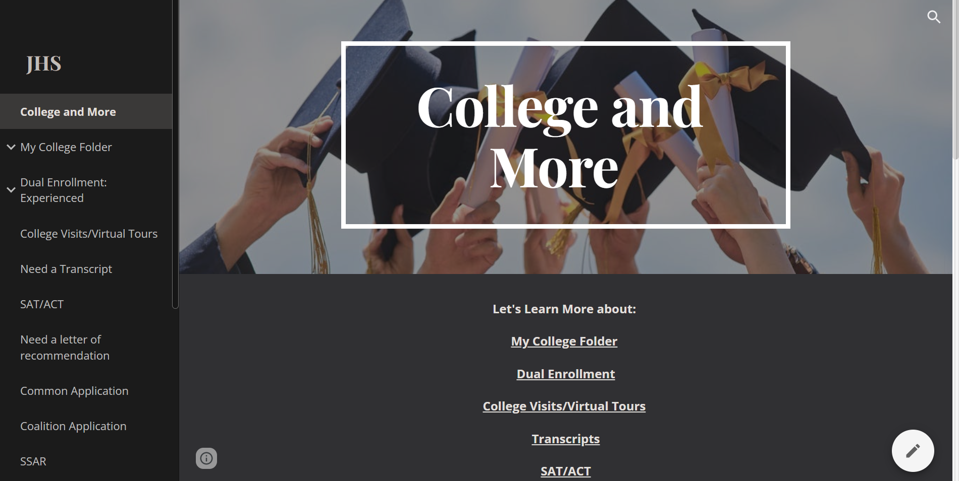
An Invaluable Application Resource
Visit “College & More” under students/parents to counseling/guidance to “College and More”:
https://sites.google.com/palmbeachschools.org/jhscollege/college-and-more

